Slide 1

SDET Course
Design Patterns - Factory Method

Slide 2
3 Types of Design Patterns
Creational
Singleton
Builder
Prototype
Factory Method
Abstract Factory
Structural
Adapter
Composite
Proxy
Flyweight
Bridge
Facade
Decorator
Behavioral
Strategy
Observer
Command
Memento
State
Template Method
Mediator
Chain of Responsibility
Interpreter
Visitor
Iterator

Slide 3
Agenda
Description
Diagram
Code sample (Java)
Use cases

Slide 4

Description
Introduction - Food stands in an amusement park

Slide 5
Description
The Factory Method Design Pattern is a creational pattern that provides an interface for creating objects in a superclass but allows subclasses to alter the type of objects that will be created. This pattern is particularly useful when there is a need to encapsulate the instantiation process of a product, making a class independent of how its objects are created, composed, and represented.

Slide 6
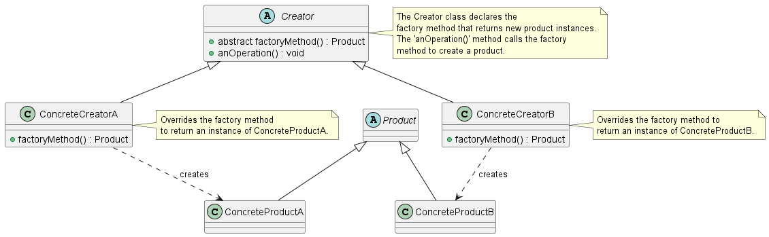
Class Diagram

Slide 7
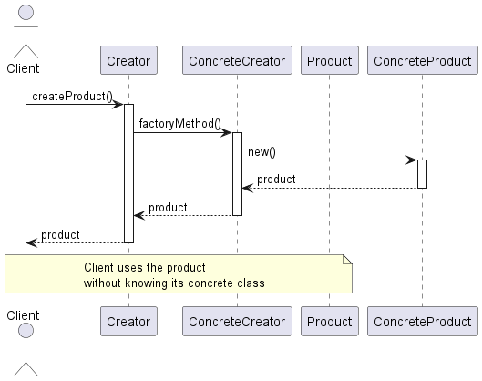
Sequence Diagram

Slide 8
Code Sample

Slide 9
Use cases
General
Browser Instance Creations
Data export (pdf, csv, xlsx)
UI component different OS
In Test Automation
Browser instance creation
Test data generation
Configurable test environment setup
Page objects factory

Slide 10
Happy Coding

